Slide 1
Feature Selection Methods

Slide 2
Sometimes we have too many features in the dataset, Shall we use them all?
The Answer is NO..
Why?
Some features are uncorrelated to the target variable
Some features are inter-correlated
Higher feature dimension often leads to overfitting
Model become highly complex and have high variance

Slide 3


Two approach to solve the problem
Hand-Picking the features
Statistical ways to select the features

Slide 4
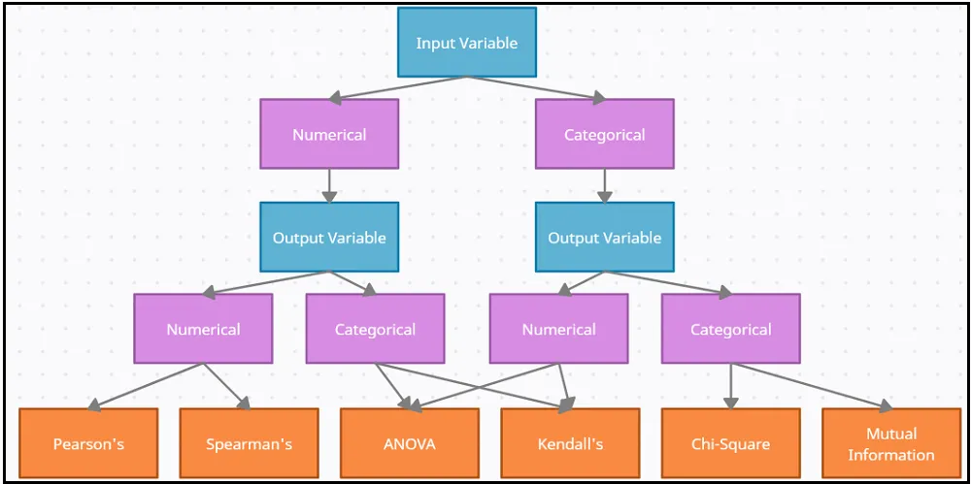
Feature selection Methods

Slide 6
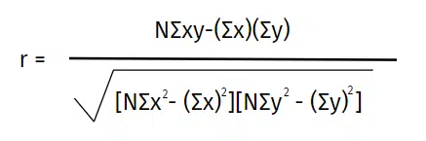
Pearson Coefficient
Pearson correlation coefficient formula and calculation
The correlation coefficient formula finds out the relation between the variables. It returns the values between -1 and 1. Use the below Pearson coefficient correlation calculator to measure the strength of two variables.
pearson formula
Where:
N = the number of pairs of scores
Σxy = the sum of the products of paired scores
Σx = the sum of x scores
Σy = the sum of y scores
Σx2 = the sum of squared x scores
Σy2 = the sum of squared y scores

Slide 7
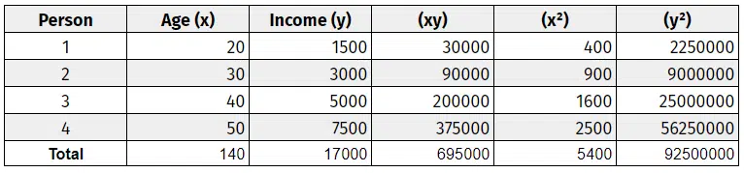
Pearson Coefficient Example
Given age as one feature calculate its importance on target variable income

